Slide 1
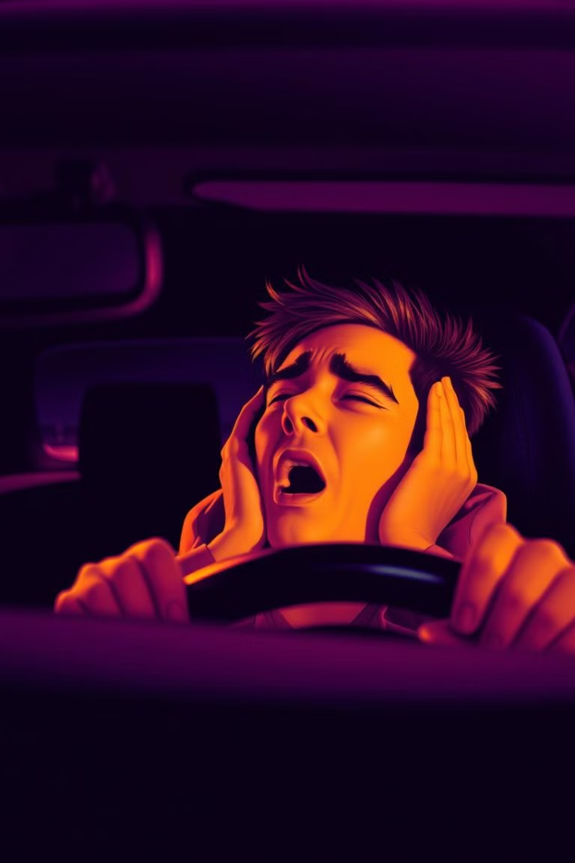
Anti-Sleep Alarm System for Drivers: An Arduino-Based Solution
Drowsy driving is dangerous. This project presents a smart system using Arduino to help keep drivers awake. It detects drowsiness in real-time to prevent accidents and improve road safety.

Slide 2
The Problem: Drowsy Driving
Impaired Abilities
Similar to Alcohol
High-Risk Groups
Drowsiness affects reaction time and focus.
Staying awake for 18 hours affects your body like having a blood alcohol level of 0.05%, which can slow your reactions and make driving unsafe.
Truck drivers and young people are at a higher risk.
Feeling sleepy slows your thinking, makes you react slower, and leads to bad decisions. Drowsy driving causes huge financial losses every year

Slide 3
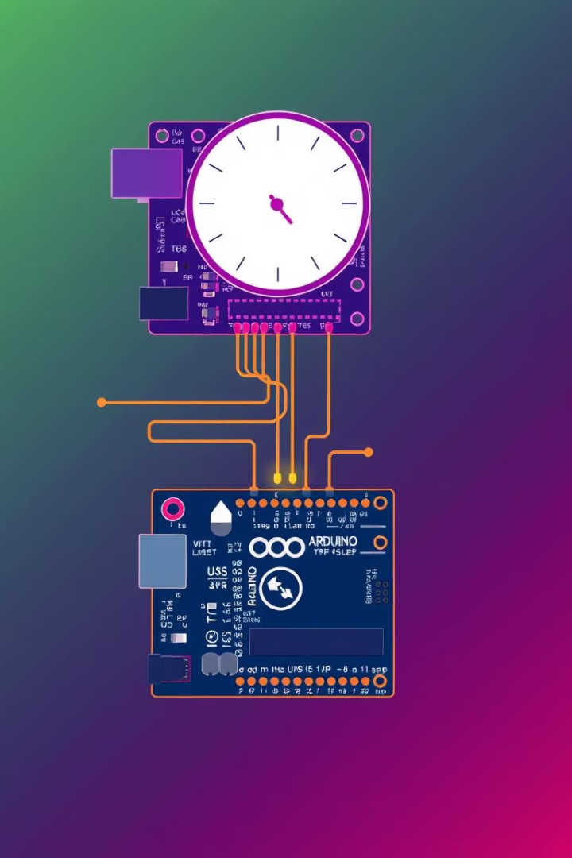
Proposed Solution: Arduino-Based Anti-Sleep Alarm
1
System Overview
Detects drowsiness and alerts the driver.
2
Non-Intrusive
Operates in real-time without distractions.
Cost-Effective
3
Uses affordable components.
4
Working Principle
Monitors eye closure and head movements.
The system provides real-time monitoring. It alerts drivers to prevent accidents. It uses accessible technology.

Slide 4
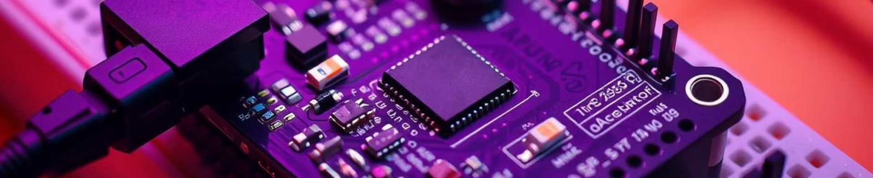




Hardware Components
Arduino Nano
IR Sensor
Accelerometer
Buzzer/Alarm
Microcontroller brain.
Detects eye closure.
Measures head movements.
Provides audible alert.
Key components include the Arduino Nano, IR sensor, and accelerometer. These components are readily available.

Slide 5
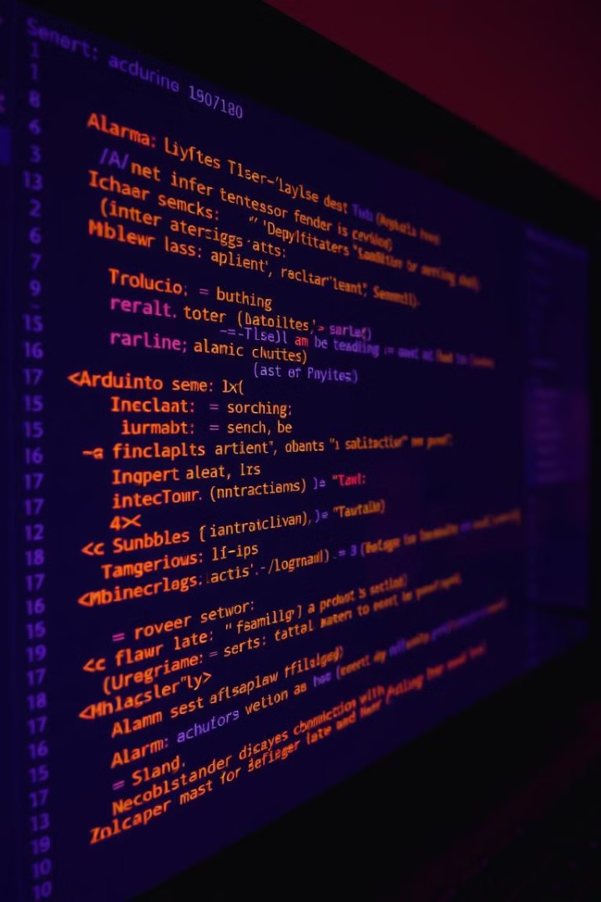



Software Implementation
Data Input
Reads sensor data.
Data Analysis
Identifies patterns.
Alarm Trigger
Activates alert on drowsiness detection.
The Arduino IDE helps with coding. The program reads sensor data and sounds an alarm if it detects drowsiness. The software can be changed if needed.

Slide 6
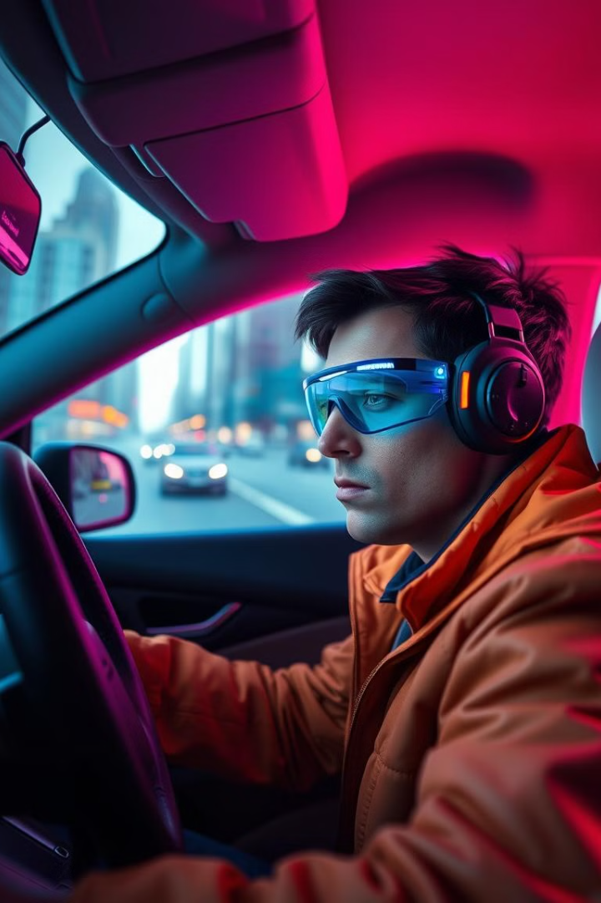
System Operation & Testing
Real-Time Monitoring
Tracks eyes and head.
Adjustable Settings
Sensitivity calibration for drivers.
Alarm Activation
Loud buzzer and visual alert.
High Accuracy
90% accuracy in tests.
The system watches drivers live. It can adjust for different drivers. Tests show it is 90% accurate.

Slide 7
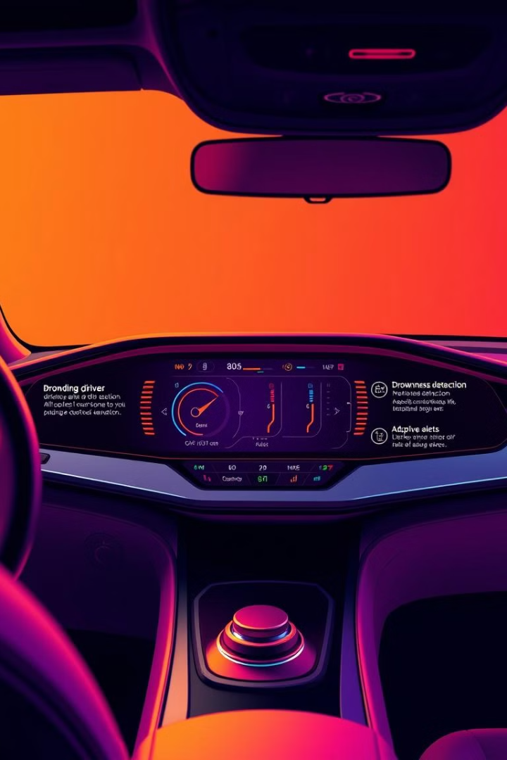
Future Enhancements
1
GPS Integration
Alerts emergency contacts.
2
Data Logging
Records drowsiness events.
3
Vehicle Integration
Reduces speed or lane assist activation.
4
Machine Learning
Improves accuracy.
Future versions will have GPS and record data. They will also connect with vehicles. Machine learning will make them more accurate

Slide 8

Conclusion: Enhancing Driver Safety
Effective
2
Affordable
1
3
Customizable
This system is a low-cost way to prevent drowsy driving. It can save lives. Anyone can modify it because it is open-source

